Slide 1
GHHI’s Whole House Model and Application
Nationally and in Rhode Island
Ruth Ann Norton, President and CEO
Green & Healthy Homes Initiative
November 17, 2025

Slide 2
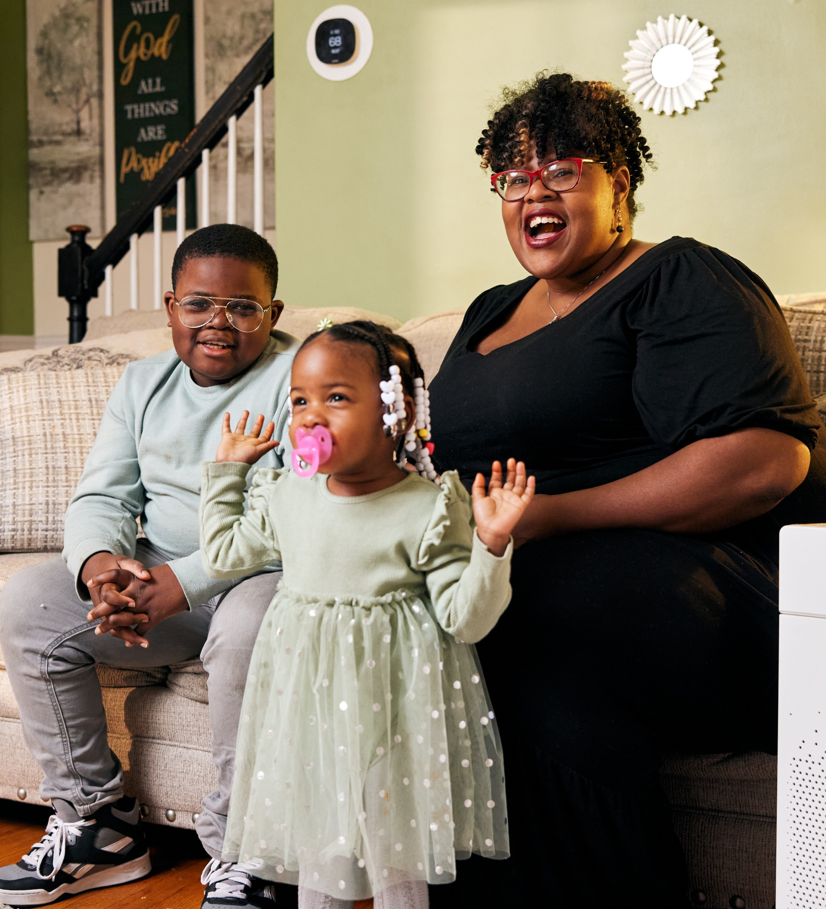

Green & Healthy Homes Initiative
Vision
Protecting public health and advancing housing stability in economically challenged communities.
Mission
GHHI addresses the housing-based causes of lead poisoning, asthma, injury, and energy inefficiency by creating homes that are healthy, safe, and resilient. By delivering a standard of excellence through data-driven solutions, GHHI aims to eradicate the negative health impacts of unhealthy housing for children, seniors, and families to ensure everyone has the opportunity to live, learn, work, and play in homes that support their health and well-being.

Slide 3
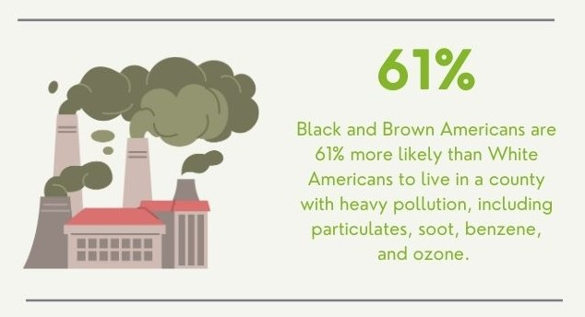
Housing Quality is a Matter of Health, Racial, and Economic Equity
Communities of color are more likely to live in unhealthy homes, causing disproportionate rates of lead poisoning, asthma episodes, energy insecurity, and severe economic effects.
Energy efficiency and appliance electrification interventions can reduce carbon emissions but also impact health by improving indoor air quality, reducing extreme heat and cold, and addressing safety risks such as carbon monoxide poisoning.
American Lung Association

Slide 4
Whole House - Aligning, Braiding, and Coordinating

Slide 5
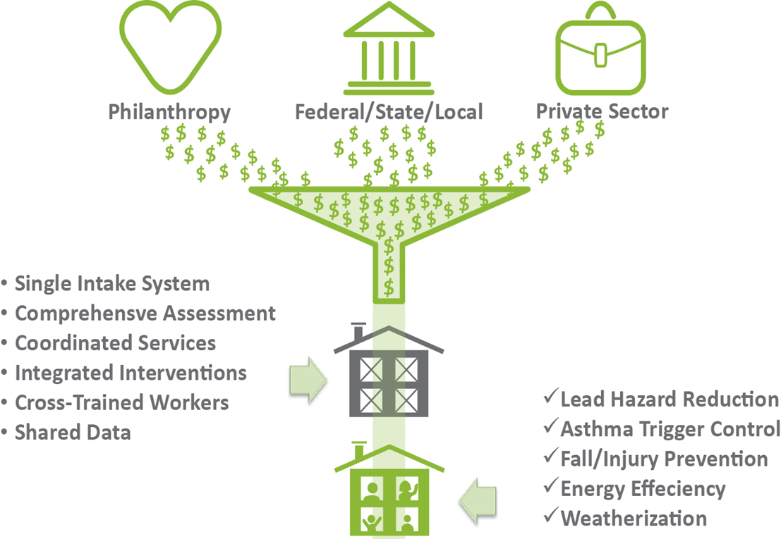
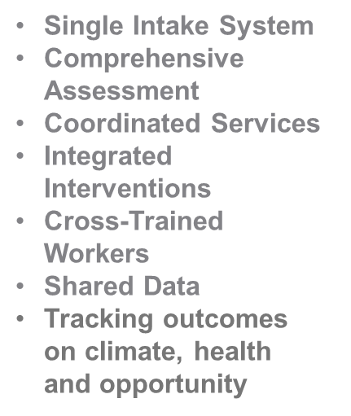
GHHI Model: Aligning Resources for Holistic Housing Retrofits in Occupied Homes
• Adoption of Whole House Approach
• Supports housing and community stability, increased housing values, wealth transfer
Align
services & funding
Braid
multiple resources to prevent client deferral
Lead Hazard Reduction
Asthma Trigger Control
Fall/Injury Prevention
Energy Efficiency
Weatherization
Housing Rehabilitation
Electrification
Decarbonization
Coordinate
improve service delivery

Slide 6

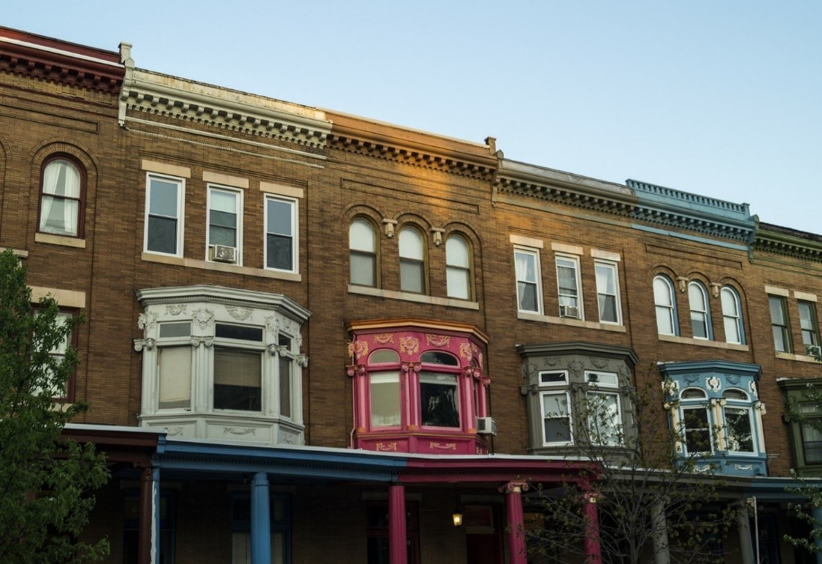
GHHI’s Whole-House Strategy
Addressing the Root Causes in Homes
Hazard Recognition, Risk Assessment, Risk Management, and Phased Scope of Work to Address Multiple Intervention Needs:
Lead-based paint hazards
Asthma triggers (Mold, pests, VOCs)
Injury hazards (Falls, fire, poisoning, etc.)
Radon and asbestos hazards
Energy efficiency/weatherization issues
Electrification/decarbonization
Solar panel installation
Housing rehabilitation
Conducted by cross-trained housing assessors, educators, and contractors addressing housing issues holistically​

Slide 7
Telling Your Story Through Improved Data Tracking and Client Success Stories – Invest in Data and Evaluation Staffing and Systems
Building the Case for Innovative and Cross Sector Investments in Housing Interventions
(Co-Benefits and Partnerships)

Slide 8
Elements of a Healthy Home
Keep it dry
Keep it well-ventilated
Keep it safe
Keep it contaminant free
Keep it pest free
Keep it clean
Keep it well maintained
Make it energy efficient
Make it all-electric
Make it decarbonized

Slide 9





Results of GHHI’s Whole-House Approach in Baltimore at the Client Level
66% reduction in asthma-related hospitalizations
62% increase in asthma-related perfect school attendance
88% increase in parents not missing work due to their child’s asthma condition
Over $2,000 in Medicaid savings per child for children with asthma within 12 months compared to
control group
$404 average annual energy cost reduction per home

Slide 10
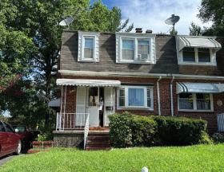
Case Study: 5612 Seward Avenue
Assessment Findings
Defective roofing causing water infiltration
Inadequate and improperly installed attic insulation
Water leaks causing wood rot
Poor weatherization and lacking air sealing
Natural gas stove not ventilated
Inadequate ventilation in bathrooms and laundry room
Natural gas furnace and central air conditioning systems malfunctioning
Defective water faucets
Toilet not properly outfitted for occupants
Plumbing leaks
Missing and defective railings
Energy inefficient appliances
Trip and fall hazards
Energy inefficient lighting

Slide 11
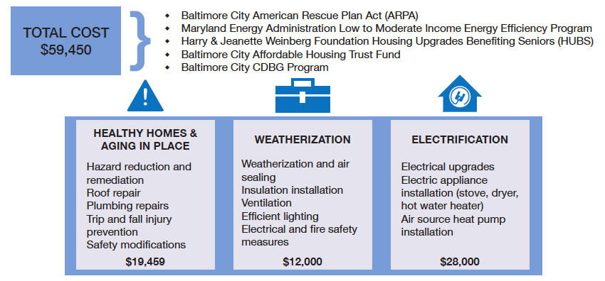
Funding & Scope of Work

Slide 12
Unlocking New Funding - Innovative Financing and Capitalizing on Healthcare and Energy Sector Investments to Scale Housing Intervention Resources

Slide 13
Utilize Innovative Funding to Create Sustainable
Housing Services for Preventive Health Impact at Scale
Hospital Investment:
$50M in Lancaster General Hospital funds are being invested in lead remediation in homes in Lancaster County, PA; GHHI managing lead remediation with over 745 homes remediated in 47 months
$52.5M in Cleveland Clinic funds for testing and lead remediation of homes in Cleveland
Whole House Models/New Funding Sources
New Jersey Lead Funding - $170M ARP
Pennsylvania Whole Home Repair-$125M ARP
City of Milwaukee Lead & Energy - $27M ARP
Sustainable Financing Examples
Public-Private Partnerships:
Michigan Lead Fund - state’s initial $2M for loan loss reserve estimated to have 30x multiplier in loan activity and will leverage private investment
Wellpoint-MD Asthma Services (420 clients)
BCBS-NC Older Adult Fall Prevention (465)
Affinity by Molina-NYC Healthy Homes Collaborative Asthma Services (850 clients)
Government: Medicaid/CHIP Health
Services Initiatives (HSI)
Rhode Island Rule 1115 Waiver
States use administrative dollars and enhanced federal match to fund lead remediation, asthma care management, and other non-covered services
State examples of lead/healthy homes HSI: CA, IN, MD, MI, OH, WI

Slide 14

Partnership with Wellpoint
Direct Payment with Administrative Funds
Maryland
Wellpoint Maryland (formerly Amerigroup) entered into contracts with GHHI based on internal analysis of outcomes including reduction in total cost of care. The health plan had previously been a referral partner for several years to GHHI. GHHI has been under contract since 2018.
Wellpoint pays 75% of costs after first visit and 25% after month 5 of enrollment.
Population served: High risk asthma member
Services covered: in-home asthma resident education visits, asthma prevention supplies delivery, home environmental assessment, IPM and safety measures
Service area: Baltimore City and Prince George's County
110 members per year who are diagnosed with uncontrolled asthma receive resident education and asthma trigger reduction measures in their homes
Leveraged services: Based on the assessment and member eligibility, members are referred for structural repairs, weatherization, lead hazard control, electrification and other healthy homes remediation services.
GHHI has developed similar models for partners in Massachusetts, Rhode Island, Tennessee, Texas, and Utah.
MCO
Community-Based Organization (CBO)

Slide 15
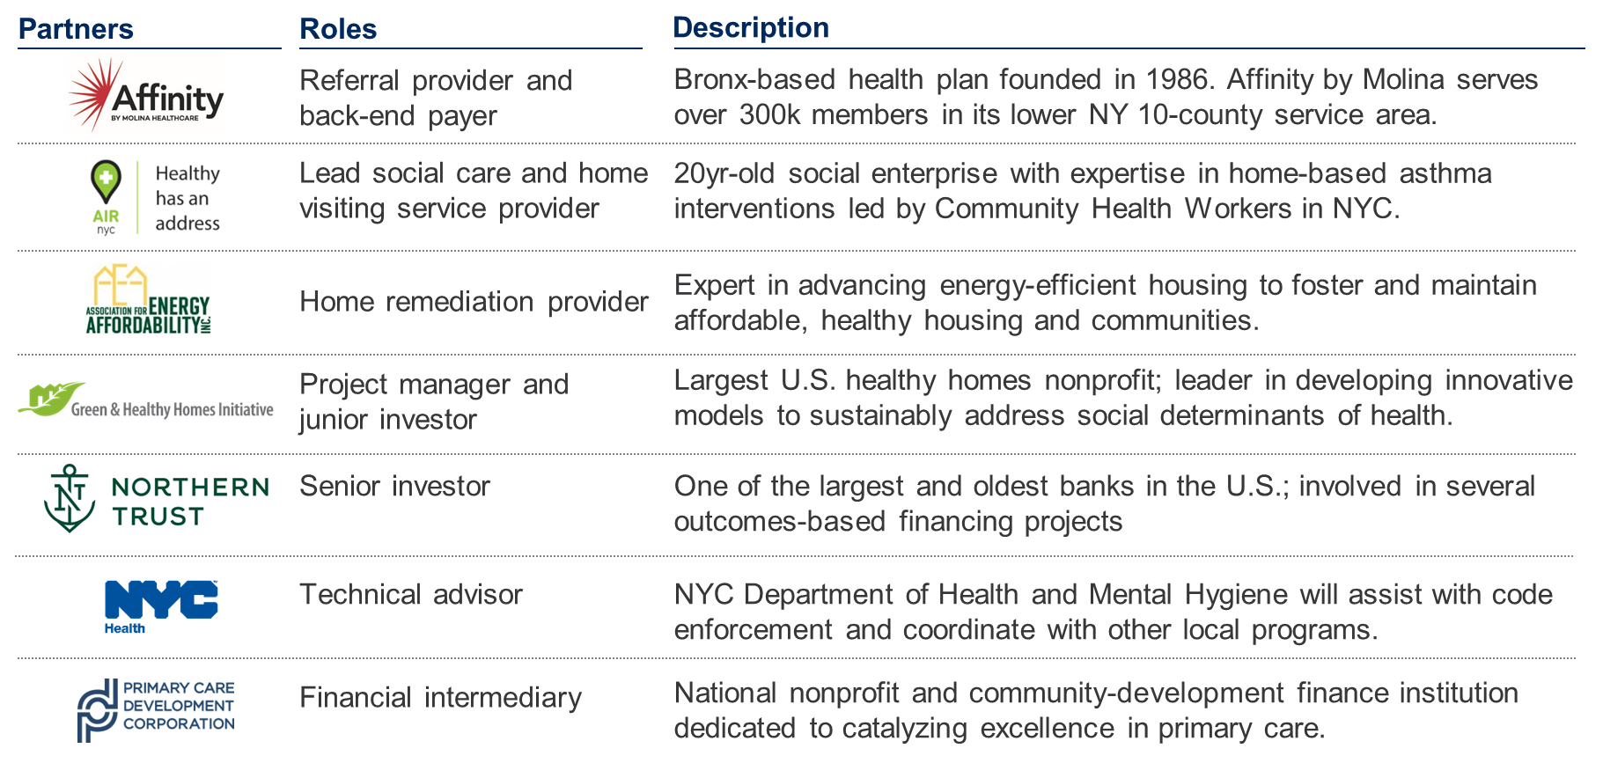
Value-Based Model / Public-Private $4.75M Investment in New York City to Serve 850 Medicaid Members with Asthma

Slide 16

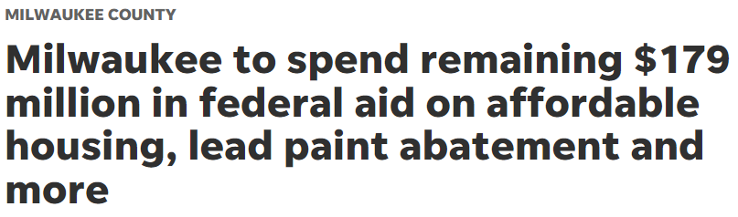


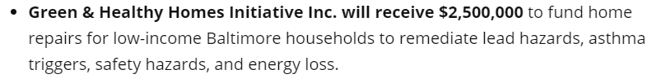
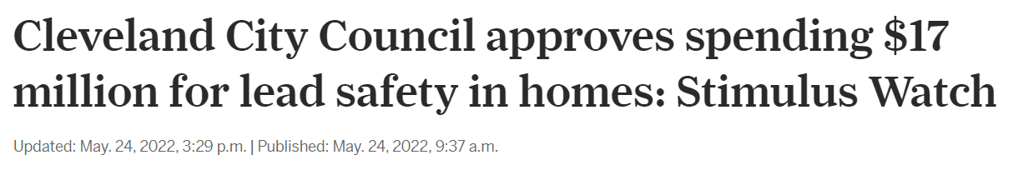
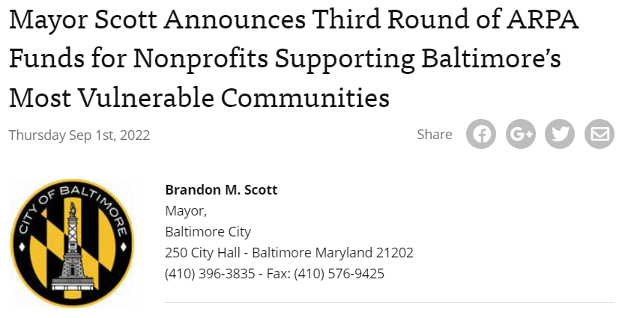

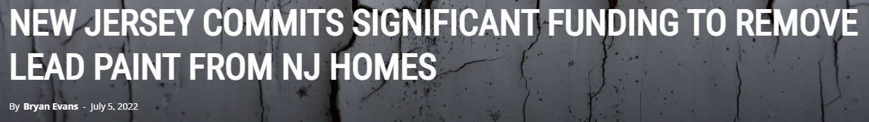

Utilizing One Time Allocations - ARP Funds for Lead Hazard Remediation and Healthy Housing
State of New Jersey - $170 million
State of Connecticut - $30 million
City of Baltimore - $12.5 million
City of Cleveland - $17 million
City of Worcester - $30 million
Cook County, IL - $30 million
Other cities: Decatur, Springfield

Slide 17
$20M Detroit Home Repair Fund – Building Local Capacity and Improving Service Delivery with Investments
11 Community Development Organizations
Training in whole home assessments, hazard prioritization, data management
Analysis of health outcomes through pre/post surveys
Coordinating Service Providers and Leveraging multiple funding streams
3 Years | 1,000 Homes | $20 Million

Slide 18
Leveraging Climate Investments –
Example: Increasing public health consensus on health benefits such as indoor air quality and natural gas appliances to spur greater funding or more flexible funding

Slide 19
Aligning Climate Change Mitigation with Energy, Health, Housing and Equity
Climate change mitigation is another pathway for healthy and affordable housing.
Shift from disinvestment and ill-conceived and unjust policies to resilient homes and neighborhoods that support children in reaching their full potential as they grow, and adults as they age with health, vitality and dignity.
Reduce deferral rates
by addressing hazardous housing conditions that prevent low-income clients from accessing energy efficiency resources.
Leverage health, housing and energy sectors in state and local implementation.
Utilize new funding to build contractor capacity, cross trained workers and address racial and economic equity through green jobs training and apprenticeships.

Slide 20
Example: Major Medical Associations are Recognizing the Link Between Gas Stoves, Indoor Air Quality and Asthma Triggers –
AMA resolution 439, 2022 Annual Meeting
“RESOLVED, That our American Medical Association recognize the association between the use of gas stoves, indoor nitrogen dioxide levels and asthma; …”
APHA Policy Statement, 2022 Annual Meeting
Gas Stove Emissions Are a Public Health Concern: Exposure to Indoor NO2 Increases Risk of Illness in Children, Older Adults, and People with Underlying Health Conditions
8. [APHA] Calls upon state and local authorities responsible for building codes to legislate the inclusion of whole-home ventilation and outdoor-venting exhaust hoods in all new buildings and remodels, adhering to ANSI/ASHRAE Standard 62.2.
9. Calls upon local and state legislative and regulatory bodies to adopt residential building codes with preferences for installing electric appliances and to require electric appliances for building projects receiving municipal or state funding. Funding for retrofits or building upgrades should have stipulations that minimize displacement.
Notes:
https://www.ama-assn.org/system/files/a22-resolutions.pdf

Slide 21
GHHI – Rhode Island
GHHI has supported the creation of healthy housing in Rhode
Island for 15 years and provides technical assistance, healthy housing assessment, education, and remediation services to improve health outcomes, resolve pre-weatherization barriers, and advance electrification and decarbonization.

Slide 22




GHHI – Rhode Island Staff
Notes:
22

Slide 23

Healthy Providence Healthy Homes – Using a Whole House Approach to Work with Two Key Target Audiences
Adults & Children Living w/ Poorly Controlled Asthma in the City of Providence
Supporting healthier families by addressing asthma triggers and health hazards through a coordinated whole-home approach paired with in-home resident education to improve asthma control and management.
2) Households Deferred from the CAPP’s Weatherization Assistance Program
Helping households overcome health and safety barriers that prevent weatherization, including knob & tube wiring removal/replacement, roof repairs/replacement, and clutter issues, enabling access to long-term cost savings, comfort, and energy efficiency/weatherization upgrades and supporting GHG reduction.
Driving Whole-Home Health, Safety, & Electrification: GHHI RI is expanding its whole-home intervention model, addressing health and safety barriers to include replacing outdated inefficient HVAC systems, and moving homes towards full electrification. This investment strengthens our current work and enables more comprehensive upgrades such as energy-efficient HVAC, heat-pump water heaters, induction stoves, and dryer replacements.
Notes:
Updates:
GHHI and CAPP executed an agreement to receive referrals from CAPP for deferred units
We are working toward updating our work plan to now also include asthmatic adults!

Slide 24
Program Eligibility & Services
MANDATORY PROGRAM ELIGIBILITY CRITERIA:
Property located in the City of Providence
Homeowner or tenant occupant meets the HUD income requirements of below 80% AMI
And
Asthma-diagnosed child ages 2-17 or adult residing in the unit
Or
Deferred/Referred from CAPP’s Weatherization Assistance Program
ELIGIBILITY PROPERTIES WILL RECEIVE:
Free environmental home assessments
Free Healthy Homes Hazard Reduction Interventions, working with CAPP and the City of Providence, PRF, others to braid home repair, weatherization, energy efficiency, and lead hazard control wherever feasible
In-Home Resident Education and Healthy Homes Indoor Allergen and Safety Kits for asthma clients.
Other additional housing, asthma, and social support services as needed

Slide 25
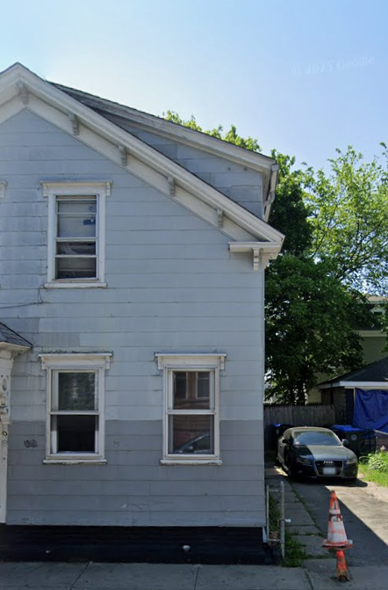
Key Program and Referral Partners
City of Providence
Community Action Partnership of Providence (CAPP)
Comprehensive Community Action
Hasbro Children’s Hospital-Brown University Health
Integra Community Care Network
Providence Revolving Fund
Rhode Island Energy
Rhode Island Builders Association
Rhode Island Housing
Rhode Island Office of Energy Resources
Rhode Island Department of Health
St. Elizabeth Community
US Department of Housing and Urban Development

Slide 26
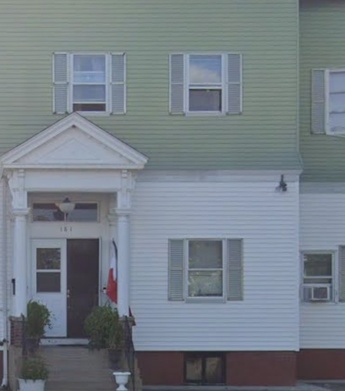
Current Program Status
78 units enrolled or in pre-intake
78 units assessed for health and safety hazards
52 units in bidding process, under contract, or in construction
17 units completed, 1 pending lead clearance
10 units sent back to CAPP for Weatherization
3 previously deferred units have completed Weatherization
Average GHHI cost per unit = $15,950
Asthma clients experiencing improvements in asthma severity and control
100% client satisfaction rate based on post intervention surveys
Launching Providence Whole House + Electrification Pilot this month utilizing new RGGI resources via partnership with OER.

Slide 27
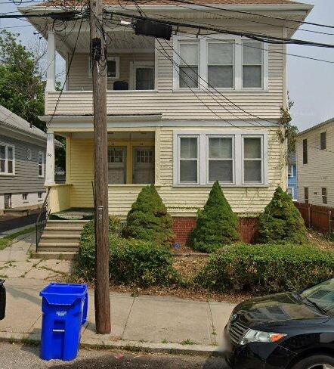
Funding & Scope of Work
Unit Background: Mr. Paul, an elderly homeowner, was deferred from CAPP’s Weatherization Assistance Program due to severe household clutter, debris, and significant health & safety hazards throughout the home.
Key Assessment Findings:
  Excessive clutter and blocked pathways across all floors
  Electrical and plumbing safety concerns
  Moisture intrusion and ventilation issues
  Frayed asbestos pipes in the basement
  Pest and sanitation concerns
  General home disrepair preventing safe weatherization work
Context:
To address needs in the unit, supplemental funding was secured through St. Elizabeth Community, a nonprofit organization focused on providing excellent care and services to older adults. This support allowed partners to address critical hazards, restore the home to a safe condition, and address CAPP’s deferral reason which ultimately returned Mr. Paul to the Weatherization Program for additional energy efficiency and weatherization improvements

Slide 28


Funding & Scope of Work
Total Cost
$33,498.02
Green & Healthy Homes Initiative – Rhode Island
Community Action Partnership of Providence County
St. Elizabeth Community
Healthy Home & Safety Interventions
Kitchen & Attic Repairs
Water Heater Replacement
Asbestos Mitigation
Pest Control Services
Clutter/Hoarding Removal
Exterior Fascia Repair
Roof Repair
Weatherization
Attic Air Sealing & Insulation
Wall Insulation
Seal Chimney Chase
Door Sweep & Weatherstrip Front Door
ASHRAE Bath Fan Installation
CO2/Smoke Combo Alarm
Bath Vent Kit Installation
Electrification
Electrification and electrification-readiness measures coming soon!

Slide 29
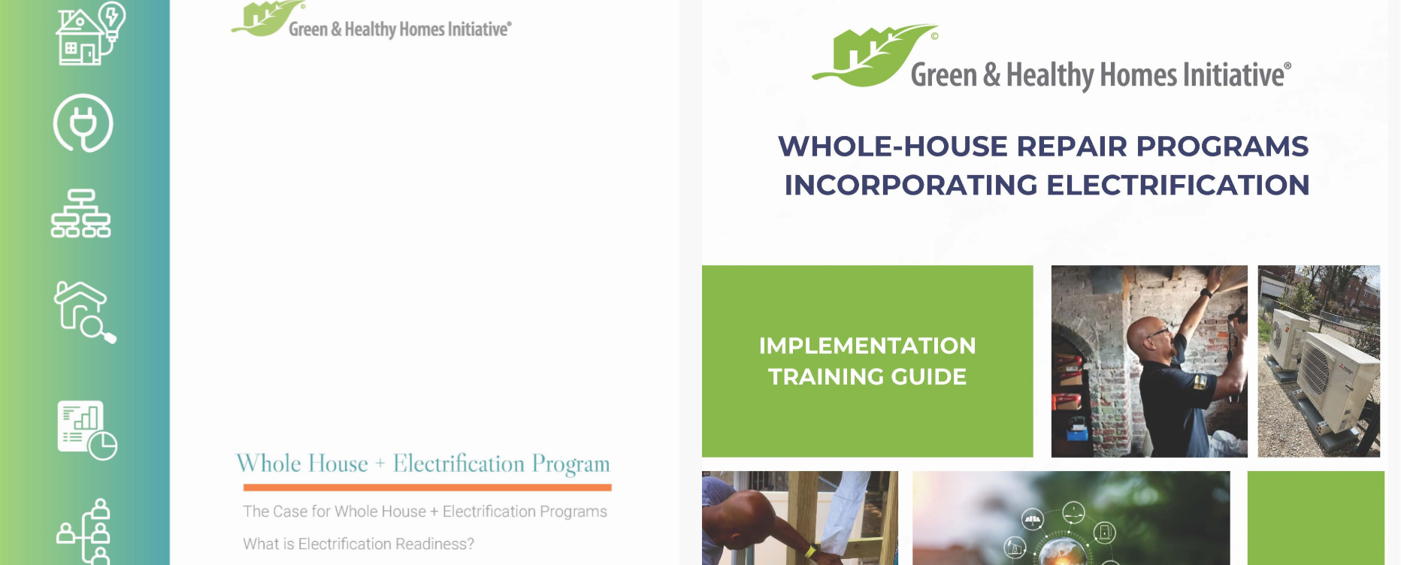
To learn more about Whole House + Electrification, please visit greenandhealthyhomes.org

Slide 30
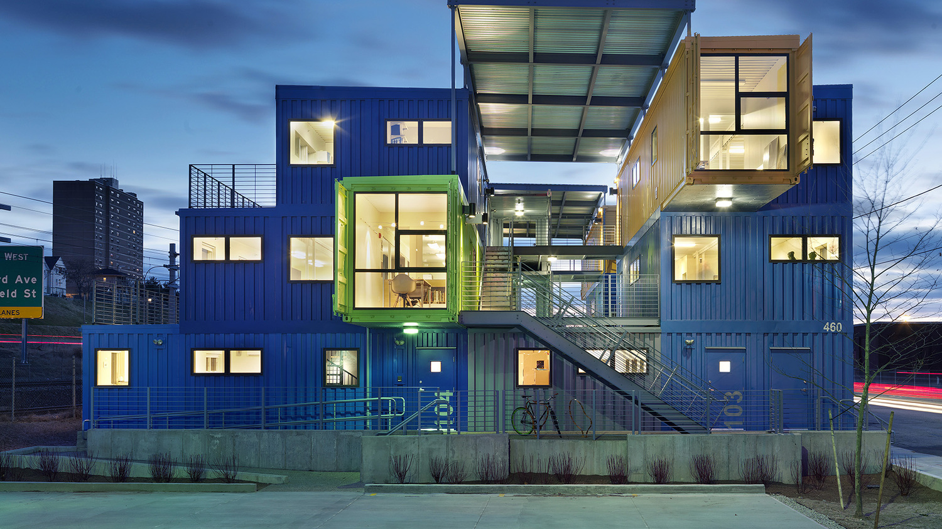



Questions?
www.ghhi.org
@HealthyHousing
GHHInational
healthy housing

Slide 31
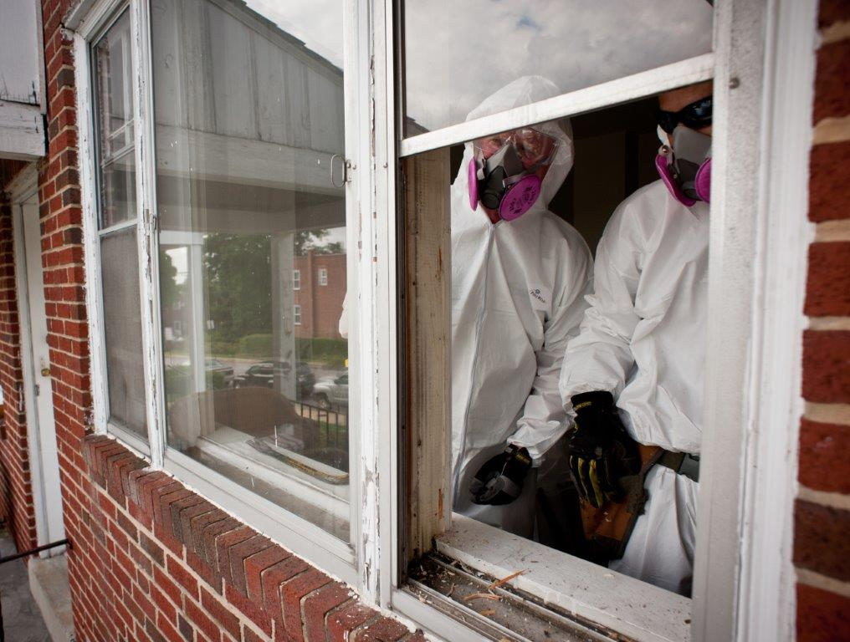



Ruth Ann Norton
President & CEO
Green & Healthy Homes Initiative
ranorton@ghhi.org
www.ghhi.org
@HealthyHousing
@RuthAnnNorton
GHHInational
healthy_housing

